Slide 1

TCP CONGESTION CONTROL: SLOW- START ALGORITHM
School of Computer Science Engineering and Technology
Bennett University Greater Noida – 201310

Slide 2
TRANSMISSION CONTROL PROTOCOL
Connection-oriented, reliable protocol
Explicitly defines following phases:
Connection Establishment
Connection Teardown
Data Transfer
To provide a connection-oriented service

Slide 3
TCP
Congestion
Congestion refers to a network state where
The message traffic becomes so heavy that it slows down the network
response time
Can arise in Packet Switched Network
Congestion leads to the loss of packets in transit
It is not possible to completely avoid the congestion

Slide 4
TCP
Congestion Control
The important service done by TCP is providing
end to end transmission
Congestion free network which is an ideal network means taking the advantage of all the bandwidth in the network
The sender's window size is determined not only by the receiver but also by congestion in the network
The sender has two pieces of information:
the receiver-advertised window size
the congestion window size

Slide 5
TCP
Congestion Control(Cont
..)
Congestion Window (cwnd) is a
TCP state variable that limits the amount of data the TCP can send into the network before receiving an ACK.
The Receiver Window (rwnd) is a
Variable that advertises the amount of data that
the destination side can receive.
Together, the two variables are used to
regulate data flow in TCP connections
minimize congestion
improve network performance.
The actual size of the window is the minimum
of these two
Actual window size = minimum (rwnd, cwnd)

Slide 6



How TCP Uses CWND and RWND
The destination indicates the size of
the receiver window through
the TCP header.
This advertises the amount of data that it can receive and enables the congestion window to determine the amount of data it can reliably transmit without an ACK.
Once received, the data is stored in the receiver buffer and the receiver sends an ACK or a set of ACKs depending on the amount of received data.
The congestion window size keeps increasing up to the maximum receiver window, or until the network reaches its limit.
However, the rate of sending data is bound to the congestion window, and even when the receiver window is large, the congestion window may be smaller – especially if the network does not support transmitting data equivalent to the maximum RWND size.
Congestion is detected either by receipt of a duplicate acknowledgement or timeout signal.
Once this happens, the TCP sender decreases the send rate by decreasing the congestion window size by a factor determined by the algorithm used.
The maximum amount of unacknowledged data that the source can send is the lower of the two windows.

Slide 7
TCP's general policy for handling congestion is based on three phases:
TCP
Congestion Control: Congestion Policy
Slow Start
Congestion Avoidance
Congestion Detection

Slide 8

TCP Congestion Control:Congestion Policy
In slow-start phase
The sender starts with a very slow rate of transmission
But increases the rate rapidly to reach a threshold
When the threshold is reached
the data rate is reduced to avoid congestion (Congestion
Avoidance)
Finally, if congestion is detected (Congestion Detection)
The sender goes back to the slow-start or congestion avoidance phase based on how the congestion is detected.

Slide 9
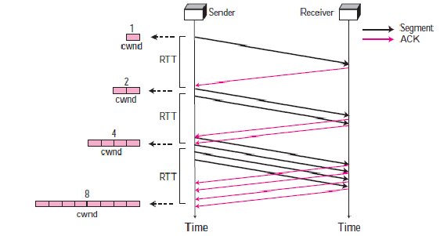
Slow Start: Exponential Increase
The slow start algorithm is based on the idea that
The size of the congestion window (cwnd) starts with one maximum segment size (MSS)
The size of the window increases one MSS each time one acknowledgement arrives
In the slow start algorithm, the size of the congestion window increases exponentially until it reaches a threshold

Slide 10
Slow Start: Exponential Increase
For simplicity, we ignore delayed-ACK policy and assume that each segment is acknowledged individually.
The sender starts with cwnd = 1 MSS.
This means that the sender can send only one segment.
After the first ACK arrives,
the size of the congestion window is increased by 1, which means that cwnd is now 2.
Now two more segments can be sent.
When two more ACKs arrive,
the size of the window is increased by 1 MSS for each ACK, which means cwnd is now 4.
Now four more segments can be sent.
When four ACKs arrive, the size of the window increases by 4, which means that cwnd is now 8.

Slide 11
Slow Start: Exponential Increase
If we look at the size of the cwnd in terms of round-trip times (RTTs), we find that the growth rate is exponential as shown below:
Start → cwnd = 1
After 1 RTT → cwnd = 1 × 2 = 2 → 2¹
After 2 RTT → cwnd = 2 × 2 = 4 → 2²
After 3 RTT → cwnd = 4 × 2 = 8 → 2³
Slow start cannot continue indefinitely.
There must be a threshold to stop this phase.
The sender keeps track of a variable named
ssthresh (slow start threshold).
When the size of window in bytes reaches this threshold,
slow start stops and the next phase starts.

Slide 12
Congestion Avoidance: Additive Increase
If we start with the slow start algorithm
the size of the congestion window increases exponentially.
To avoid congestion before
it happens
slow down this exponential growth.
TCP defines another algorithm called congestion avoidance,
which increases the cwnd additively instead of exponentially.
the size of the congestion window increases additively until congestion is detected.
In the congestion avoidance algorithm

Slide 13
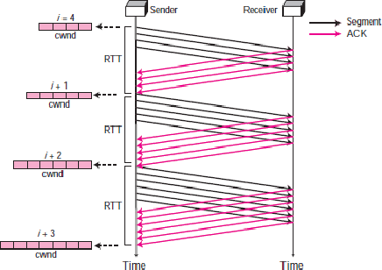
Congestion Avoidance:
Additive Increase
When the size of the congestion window reaches the slow start threshold in the case where cwnd = i,
the slow start phase stops and the additive phase begins.
In this algorithm,
each time the whole “window” of segments is acknowledged, the size of the congestion window is increased by one.
The window size increase is based on RTT, not on the number of arrived ACKs.
In this case, after the sender has received acknowledgments for a complete window-size of segments,
the size of the window is increased one segment.

Slide 14
Congestion Avoidance: Additive Increase
If we look at the size of cwnd in terms of round-trip time (RTT), we find that the rate is additive as shown below:
Start → cwnd = i
After 1 RTT → cwnd = i + 1 After 2 RTT → cwnd = i + 2 After 3 RTT → cwnd = i + 3

Slide 15

If congestion occurs,
the congestion window size must be
decreased.
The only way a sender can guess that congestion has occurred is the need to retransmit a segment.
This is a major assumption made by TCP.
Retransmission is needed to recover a missing packet which is assumed to have been dropped (i.e., lost) by a router.
Retransmission can occur in one of two cases:
when the Retransmission Time Out
(RTO) timer times out, or
when three duplicate ACKs are received.
In both cases, the size of the
threshold is dropped to
half (multiplicative decrease).
Congestion Detection: Multiplicative
Decrease

Slide 16

Most TCP implementations have two reactions:
If a time-out occurs, there is a stronger possibility of congestion; a segment has probably been dropped in the network and there is no news about the following sent segments. In this case TCP reacts strongly:
It sets the value of the threshold to half of the current window size.
It reduces cwnd back to one segment.
It starts the slow start phase again.
If three duplicate ACKs are received, there is a weaker possibility of congestion; a segment may have been dropped but some segments after that have arrived safely since three duplicate ACKs are received. This is called fast transmission and fast recovery. In this case, TCP has a weaker reaction as shown below:
It sets the value of the threshold to half of the current window size.
It sets cwnd to the value of the threshold (some implementations add three segment sizes to the threshold).
It starts the congestion avoidance phase.
Congestion Detection: Multiplicative
Decrease

Slide 17
Congestion Detection: Multiplicative
Decrease
An implementations reacts to congestion detection in one
of the following ways :
If detection is by time-out
a new slow-start phase starts.
If detection is by three ACKs
a new congestion avoidance phase starts

Slide 18
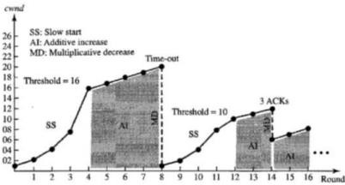
Example
We assume that the maximum window size is 32 segments. The threshold is set to 16 segments (one-half of the maximum window size). In the slow-start phase the window size starts from 1 and grows exponentially until it reaches the threshold. After it reaches the threshold, the congestion avoidance (additive increase) procedure allows the window size to increase linearly until a timeout occurs or the maximum window size is reached. In Figure, the time-out occurs when the window size is 20. At this moment, the multiplicative decrease procedure takes over and reduces the threshold to one-half of the previous window size. The previous window size was 20 when the time-out happened so the new threshold is now 10. TCP moves to slow start again and starts with a window size of 1, and TCP moves to additive increase when the new threshold is reached. When the window size is 12, a three duplicate ACKs event happens. The multiplicative decrease procedure takes over again. The threshold is set to 6 and TCP goes to the additive increase phase this time. It remains in this phase until another time- out or another three duplicate ACKshappen.

Slide 19
References
https://www.geeksforgeeks.org/tcp-congestion- control/
https://en.wikipedia.org/wiki/TCP_congestion_control
https://blog.stackpath.com/tcp-slow-start/

